Slide 1
Virtual Check-in, Check-Out (CICO)
Leanne S. Hawken, PhD, BCBA, LBA

Slide 2
Leanne Hawken, PhD, BCBA, LBA
Co-Project Director for Behavior Response Support Team
Collaboration between U of Utah & Granite School District to provide Tier 1 & Tier 2 support
Multi-Tiered System of Supports District Coach
Utah State Board Of Education
Professor, University of Utah (2002-2020)
Board Certified Behavior Analyst
Former School Psychologist
Parent implementing positive behavior support at home

Slide 3
Objectives
Resources for CICO Implementation
Overview of Traditional Check-in, Check-out (CICO)
Steps for Implementing CICO Virtually
Additional Considerations for Virtual CICO
Take Home Messages

Slide 4
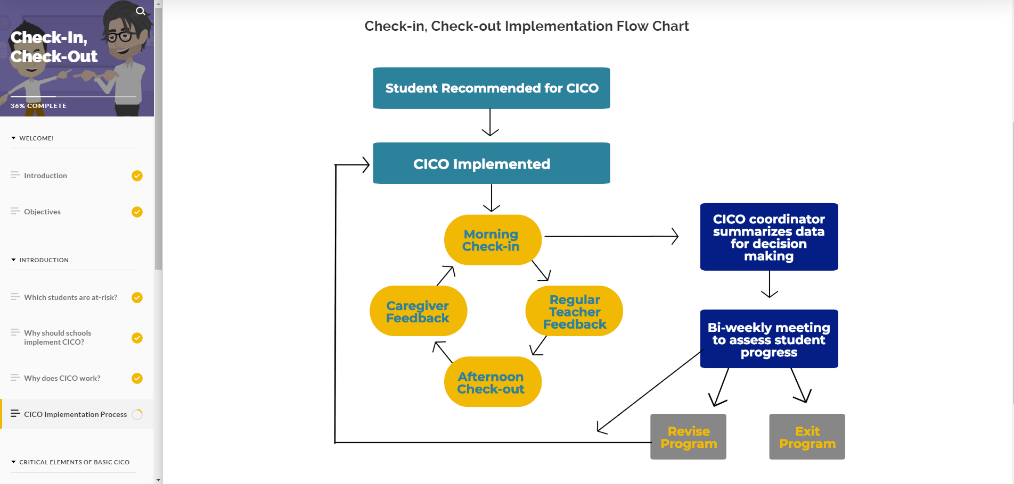
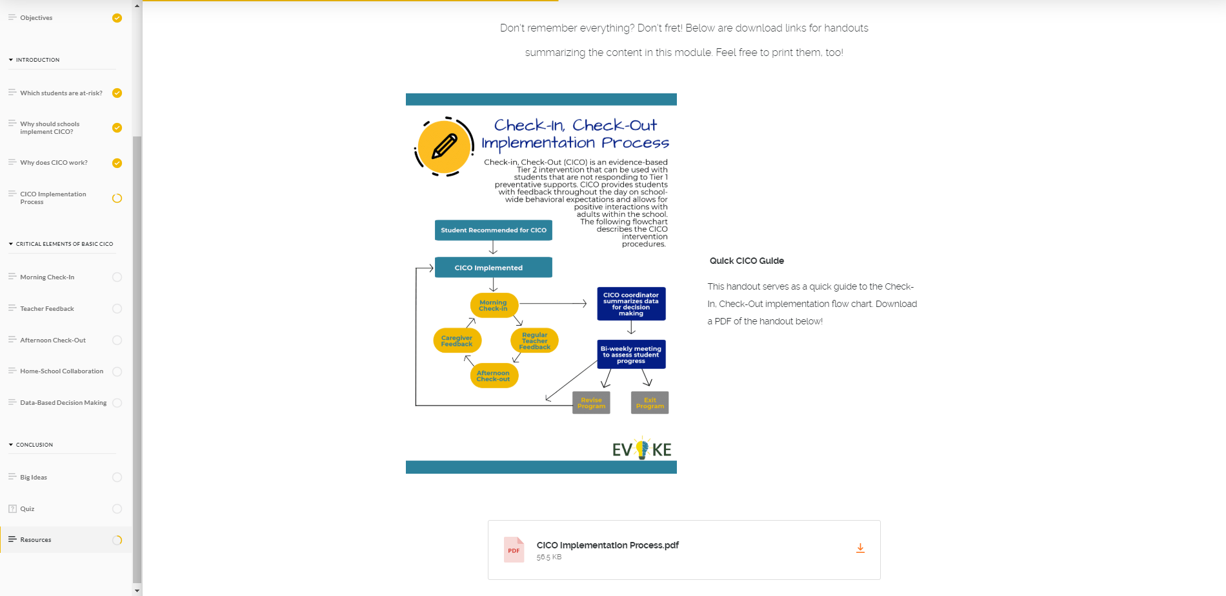
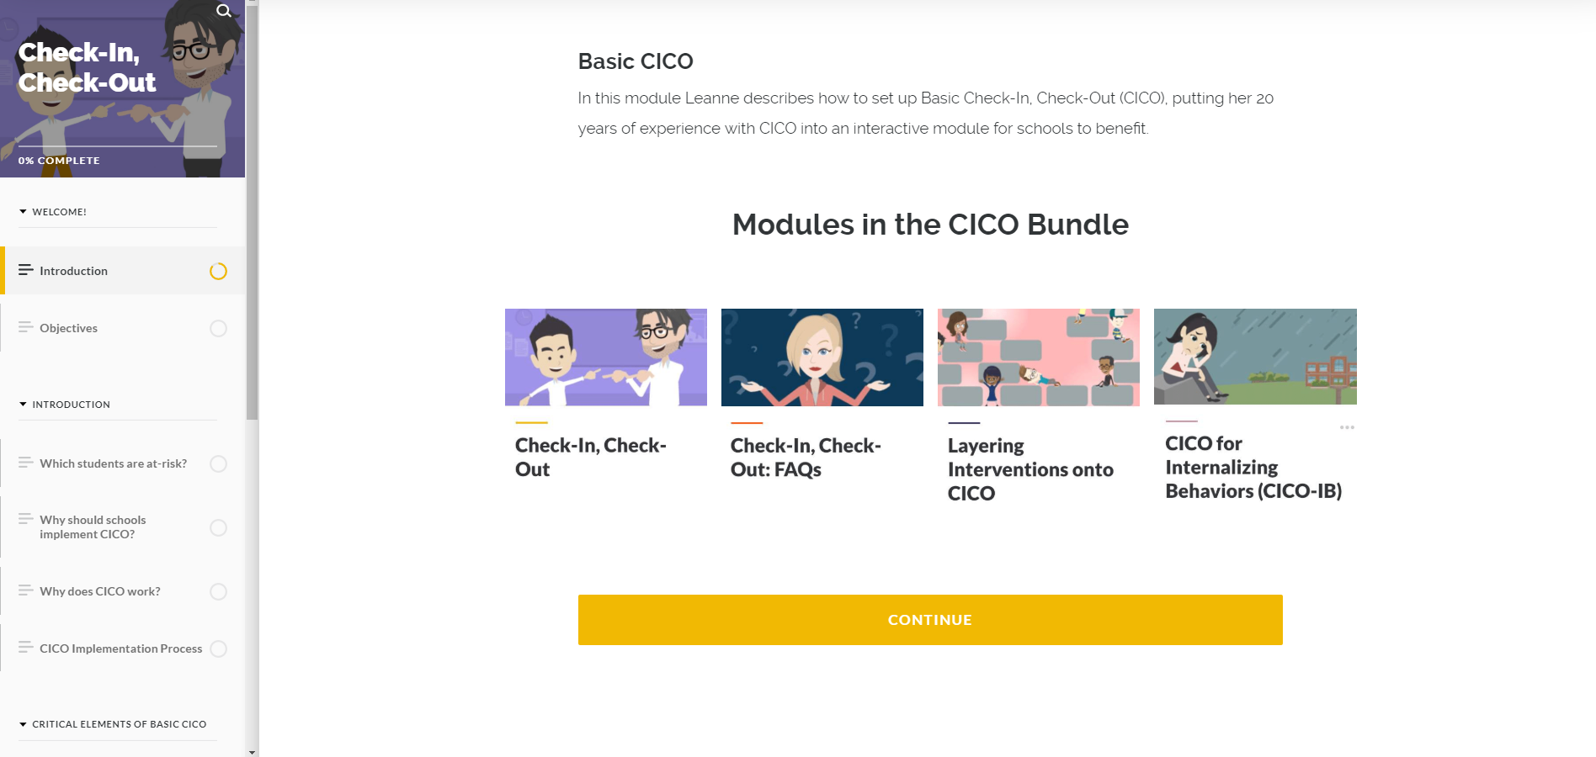
CICO E-Learning Modules
Interactive e-learning modules on CICO for schools & districts
What do the modules have to offer?
Easy-to-use web-based interface
Self-paced courses
A variety of interactions, including:
Videos with case scenarios and steps for implementation
Drag & drop matching activities
Knowledge checks
Colorful, detailed images
Downloadable resources for future reference
https://evokeschools.com/

Slide 5
Additional CICO Resources
Coming November 2020 –
DVD on How to Implement CICO

Slide 6
Acknowledgements
Michigan’s Multi-Tiered System of Supports Technical Assistance Center
Adapting Check-In Check-Out (CICO) for Distance Learning
Valerie Vandlen
Allison Olivo
Melissa Nantais
Steve Goodman
Center on Positive Behavior Interventions and Supports
Guidance for Adapting CICO for Distance Learning

Slide 7
What is Check-in, Check-out (CICO)?
The most widely implemented Tier 2 Intervention for students at risk (Bruhn et al., 2017)
An evidenced-based practice with 18 years of research supporting its efficacy in:
reducing problem behavior
externalizing and internalizing
increasing academic engagement
reducing referrals to special education for behavioral concerns.
(Drevon et al., 2019; Hawken & Horner, 2003; Hawken, MacLeod, Rawlings, 2007)

Slide 8
Student Recommended for CICO
Check-In, Check-Out Implementation Process
Teacher, Parent, Student Agree & Implementation Starts
Morning
Check-in/DPR
Pick-up
CICO Coordinator
Summarizes Data
For Decision Making
Parent/ Home
Feedback
Regular Teacher(s)
Feedback
Student Progress Assessed
1: responding, 2: needs more, 3: completed goals
Afternoon
Check-out
1: Continue
2: Add Support
3: Exit/ Graduate
Notes:
Adapted from: Crone, D., Horner, Robert H, & Hawken, Leanne S. (2010) Responding to problem behavior in schools : The behavior education program (Guilford practical intervention in the schools series).

Slide 9
Daily Progress Reports (DPRs)

Slide 10
Key Features to Consider for Virtual CICO
Connection of students with adults at school
Regular feedback/instruction on behavior
and practice in self-monitoring
Home/School Communication
Caregiver feedback
Data are used for decision making

Slide 11
Step 1: Determine Need for CICO
Team-based decision
Risk variables may be different than traditional CICO
Factors to consider
Lack of work completion
Inappropriate language or other problem behavior during virtual meetings
Lack of attendance in online meetings/instructional periods
Withdrawn and lack of active participation online

Slide 12
Assessing Student Need for Virtual CICO

Slide 13
Step 2: Determine How a Student will Check-in/Check-out
Who
CICO Coordinator or facilitator
Sample Check-in with Middle School Student
Other school staff (e.g., librarian, bus drivers, cafeteria workers)
Frequency
Daily
2-3 times per week
Monday check-in, Friday check-out
Time(s) of Day
Method
Phone call/text/voice recordings
Zoom
Google Meets

Slide 14
Step 3: Align Intervention with Student, Family, and Instructional Needs
A few distance learning scenarios:
1. Live Virtual Instruction (Synchronous)
2. Live Virtual Instruction with Home Routines Included
3. Web-Based Recordings and/or Packet (Asynchronous) Learning
Students and families will need instruction on how to participate in these options of CICO
Training script for parent
Note: These are only a few of the possible distance learning scenarios

Slide 15
Live Virtual Instruction (Synchronous)
Single Session Feedback
Feedback provided by
Teacher at end of session
Paraprofessional who has sat in on the session

Slide 16
Live Virtual Instruction with Home Routines Included
Multiple Feedback Sessions
Feedback provided by
Teacher
Parent/Caregiver
Student Self Monitoring
Sample Teacher Feedback – Elementary School

Slide 17
Web-Based Recordings and/or Packet (Asynchronous) Learning
No feedback sessions based on live interactions
Feedback provided by
Parent/Caregiver
Student Self Monitoring
If Parent/Caregiver cannot provide feedback nor child can self monitor – no DPR is needed
Coordinator/Facilitator check-in/out at agreed upon times with student

Slide 18
Step 4: Determine Reinforcement
Determine criteria for receiving reinforcement
If DPR is used = 70%-80% of points likely a good target goal
May need to start goals for reinforcement lower with some students (e.g., 50-60%) to ensure success
Sample reinforcers include:
Caregiver allows child additional time with activity of choice
Teacher has a one-on-one “virtual snack time” with student
Coordinator plays a virtual game with student or facilitates virtual social time with other students from the class (e.g., lunch bunch)
Earned “breaks” from online learning or extended lunch time
Additional student sharing time online
Telling Joke/Story
Developing and sharing a video (e.g., using Flipgrid), etc.

Slide 19
Step 4: Determine Reinforcement
No DPR used = provide frequent check-in/check-out interactions
Set weekly goal (e.g., complete 20 minutes of reading daily)
Provide praise & reinforcement for meeting weekly individualized goal
Resource for rewards for distance learning PBISRewards

Slide 20
Step 5 – Use Data for Decision Making
Platforms for Data Collection/Organization
WWW.SWIS.org
PBISRewards.com
Google Forms
Teams may need to adjust data-based decision rules for:
Measuring response to intervention
Need for additional support
Criteria for fading

Slide 21
Few More Considerations for Virtual CICO
Consider including families in the check-out process – even once a week
Get feedback on how school can be supportive re: distance learning.
If key components of virtual CICO are not going well:
what skills need to be retaught or what supports need to be put into place?
How to check-in?
How to earn points during synchronous online instruction?
How to remember to check-out?

Slide 22
Take Home Messages
Focus on key, active CICO elements
Connection of students with adults at school
Regular feedback/instruction on behavior and practice in self-monitoring
Home/School Communication
Data are used for decision making
School Staff will need to
Assess
Adapt
Monitor Progress
Readapt CICO as often as needed to maintain continuity of Tier 2 Support

Slide 23
Final Message
CICO
High Schools
Preschools
Alternative/Residential Settings
Internalizing & Externalizing Behaviors
Recess
Attendance
Academic/Organizational Deficits
We can do Virtual CICO!!!!!

Slide 24
Contact Information leanne.hawken@utah.edu leanne.s.hawken@gmail.com

