Slide 1
Welcome to Puberty Training!
Created by: Alli Wenzbauer

Slide 2
Overview
Why do we go through puberty?
Anatomy
Terminology
Changes to Expect During Puberty
Hygiene
Public v. Private
Additional Resources

Slide 3
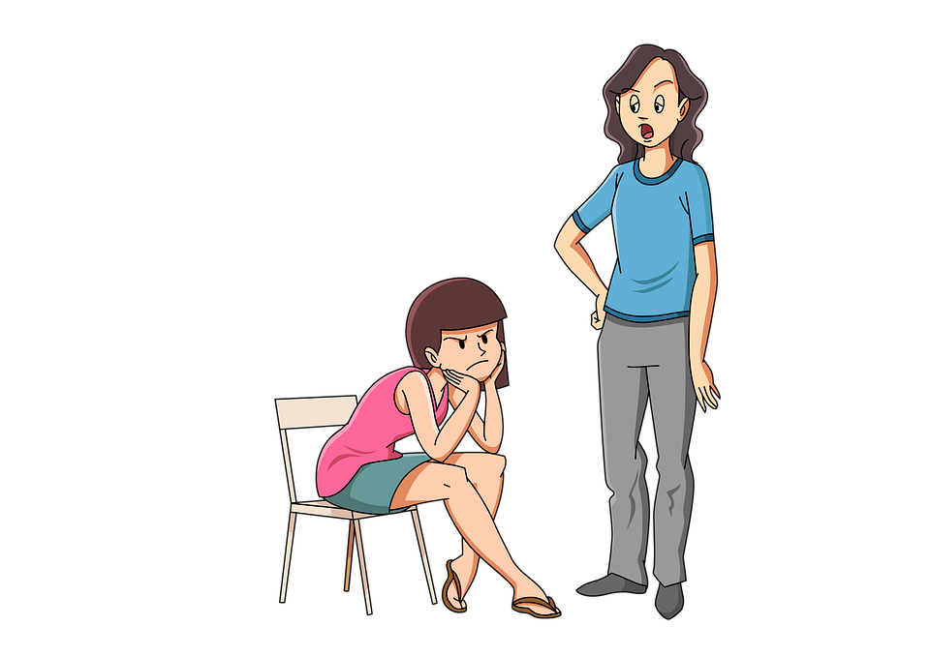
Puberty - Why?
Discussion Question: What are your biggest concerns surrounding puberty and your child?

Slide 4
Puberty is a time of physical, emotional, and social change that happens as children mature.
Puberty can begin as early as 7 or as late as 12. It is different for everyone!

Slide 5
Puberty is a series of changes that our bodies go through as they begin to develop into adult bodies. Puberty prepares our bodies for reproduction.

Slide 6
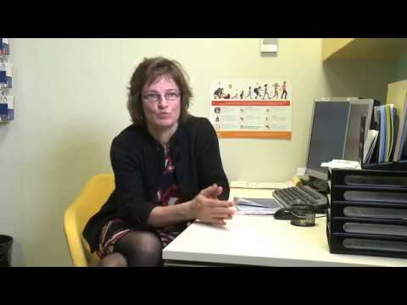
Some additional perspective

Slide 7
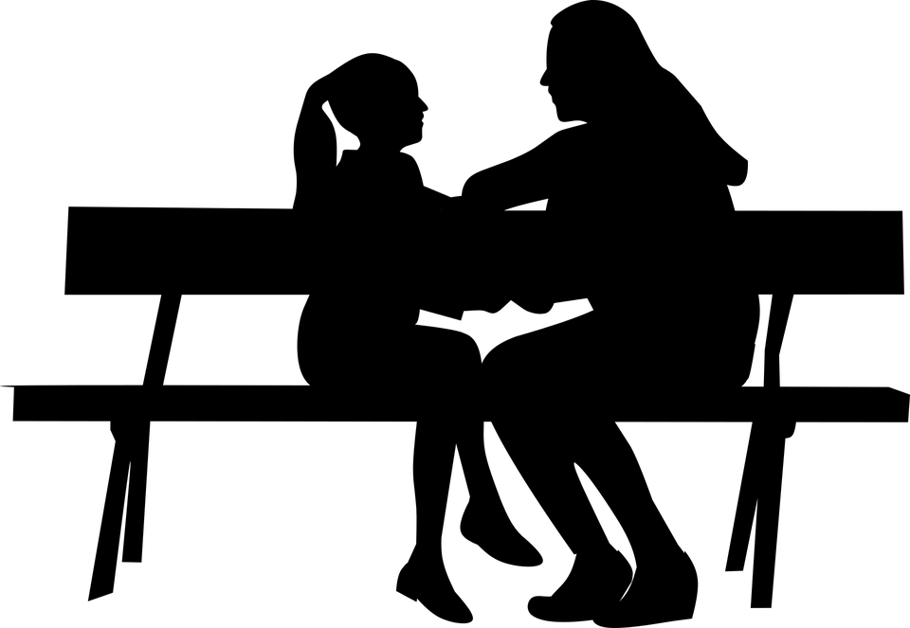
Anatomy
Discussion Question: What has been your experience discussing anatomy with your child so far?

Slide 8
Terminology - Why is it important?
It’s important for your child to know the medical terminology for their body parts. Some reasons for this may be to discuss their health with doctors, understand jokes or conversations their peers may be having, and to be able to report assault accurately, should they need to.

Slide 9
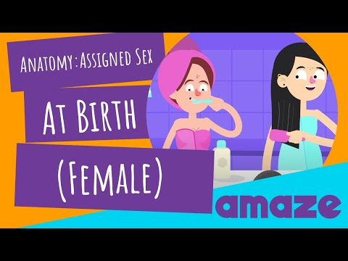

Slide 10
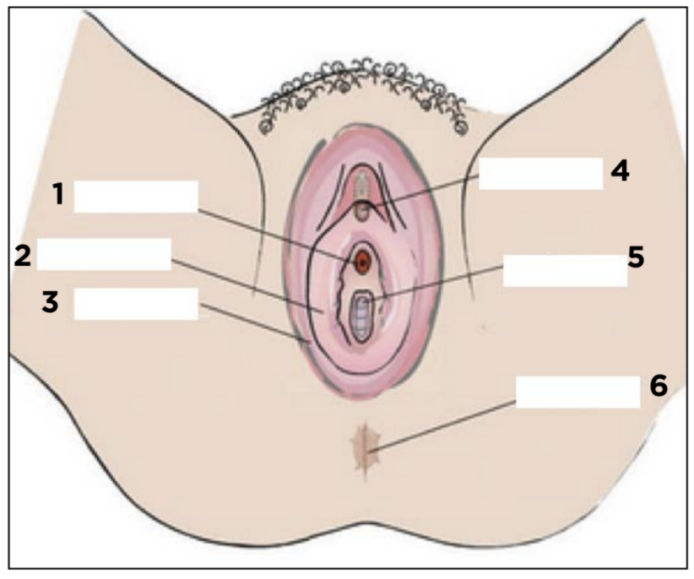
Terminology - External Parts
Vulva: The vulva is the external part of the female sex organs. It is made up of the labia, clitoris, urethral opening, and vaginal opening.
Labia majora: The labia majora protect the other external reproductive organs. The labia majora are relatively large and fleshy. They contain sweat and oil-secreting glands. During puberty, the labia majora grow hair.
Labia minora: The labia minora lie just inside the labia majora, and surround the openings to the vagina and urethra. They can be short, long, wrinkled, smooth, and even change in color as a person gets older.
Urethra
Clitoris
Labia Minora
Vagina
Labia Majora
Anus

Slide 11
Terminology - External Parts
Clitoris: The two labia minora meet at the clitoris, a small, sensitive protrusion.. The clitoris is covered by a fold of skin, called the prepuce. The clitoris is very sensitive to stimulation and can become erect.
Urethra opening: A small whole where urine leaves the body.
Anus: The opening where feces leaves the body.
Clitoris
Urethra
Labia Minora
Vagina
Labia Majora
Anus

Slide 12
Every body is different and may not look the same.

Slide 13
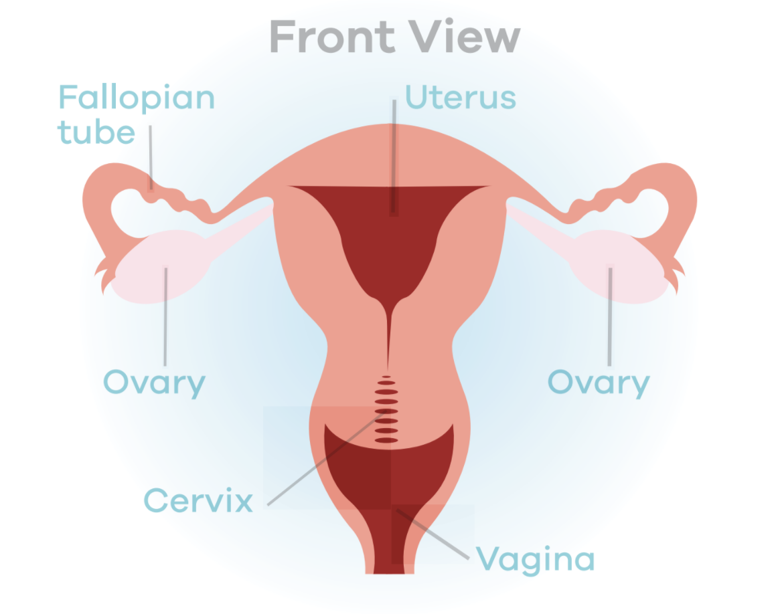
Terminology - Internal Parts
Vagina: The vagina is a canal that joins the cervix (the lower part of uterus) to the outside of the body (vulva). Menstrual fluid, discharge, and babies travel through the vagina to leave the body.
Bartholin's glands: These glands are located next to the vaginal opening and produce a fluid (mucus) secretion.
Cervix: A donut-shaped opening that connects the vagina and the uterus. The cervix allows sperm to enter and menstrual blood to exit.
Uterus: The uterus is a hollow, pear-shaped muscular organ in which a baby would grow.

Slide 14
Terminology - Internal Parts
Uterine tube/Oviduct (Fallopian tube): These are narrow tubes that are attached to the upper part of the uterus and serve as tunnels for egg cells to travel from the ovaries to the uterus. Conception, the fertilization of an egg by a sperm, normally occurs here. The fertilized egg then moves to the uterus, where it implants to the uterine wall.
Ovaries: The ovaries are small, oval-shaped glands that are located on either side of the uterus. The ovaries produce eggs and hormones.

Slide 15
Changes to Expect During Puberty
Physical
Social-Emotional

Slide 16
Physical Changes

Slide 17
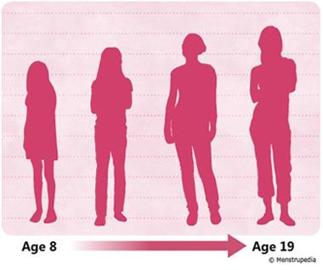
Body Changes
“Growth spurts” are common.
Your child may notice white/yellow fluid in their underwear (“vaginal discharge”).
During puberty, your child will experience many bodily changes.

Slide 18
Breast Changes
Breast development is typically one of the early signs of puberty.
There is no set time that breasts will begin to develop.
Breast may feel sensitive or sore during this time.
Your child’s breasts may grow or change.

Slide 19
The first change in breast development is a small bump under the nipple (“breast buds”).
Lumps and breast pain are common.
There is no right size or shape, and they may be uneven in size.
Wearing a bra can help support and protect your breasts.

Slide 20
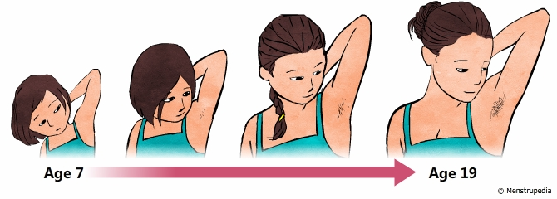
Hair Changes
The hair on the head may develop oil quicker.
New hair will start to grow on:
Legs, arms, under arms, face, stomach, chest, butt, back, and pubic area.
New and pre-existing hair may become darker and thicker.
Different for everyone.
Your child may grow more hair on their arms, legs, genitals, or face.

Slide 21
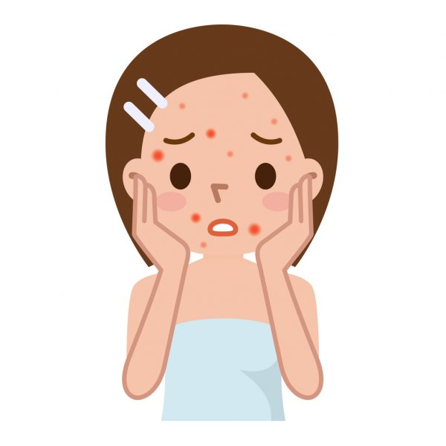
Skin Changes
The skin will produce more oil which may cause acne.
Your child’s skin will produce more sweat, especially in their under arms.
Encourage washing daily with a gentle cleanser, such as:
CeraVe – Foaming Facial Cleanser
Dove – Sensitive Skin Beauty Bar
First Aid Beauty - Face Cleanser
Encourage moisturizer, such as:
Cetaphil – Moisturizing Lotion
CeraVe – Ultralight Moisturizer
Your child may notice changes to their skin and require more care.

Slide 22
Menstruation
Typically starts within the ages of 9-16.
It prepares the body for pregnancy each month.
The menstrual cycle is controlled by hormones:
Estrogen and progesterone.
To help manage their period, menstruators can use:
Tampons, pads, period underwear, or menstrual cups.
Menstruation can have a spectrum of presentations.

Slide 23
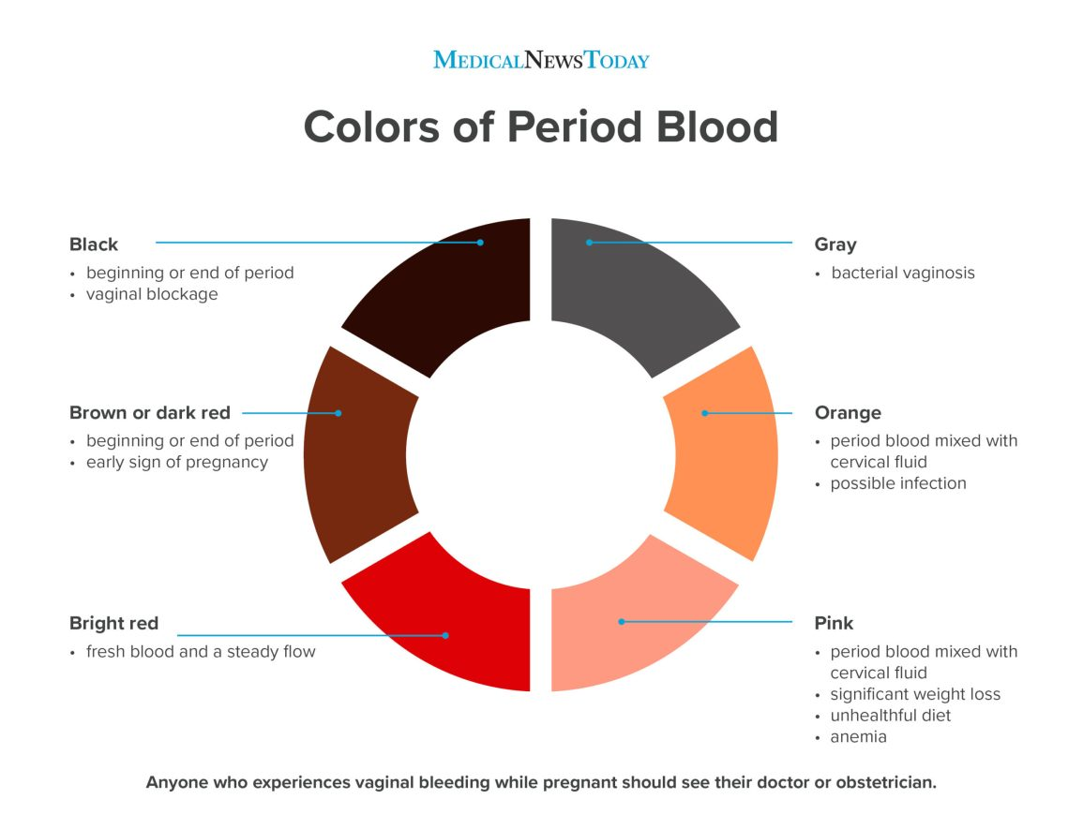
More on Menstruation
Irregularity is normal.
Blood flow (up to 3 tbsp)
Menstrual cycle (21-35 days)
Period (2-7 days)
Cramping, bloating, and emotional changes during or prior to a period is normal.
See graphic for different colors of period blood →
Contact a doctor with concerns.
Helpful resource- The Cleveland Clinic

Slide 24
Period Myths- True or False?
Periods are unclean and make you dirty.
Pubis hair is dirty or gross.
Tampons take away your virginity.
Periods start and end on the same day each month.
Anything you can do without a period, you can do with a period; like going to school, playing sports, etc.
Period blood can be different colors.
People act crazy when they are on their periods.

Slide 25
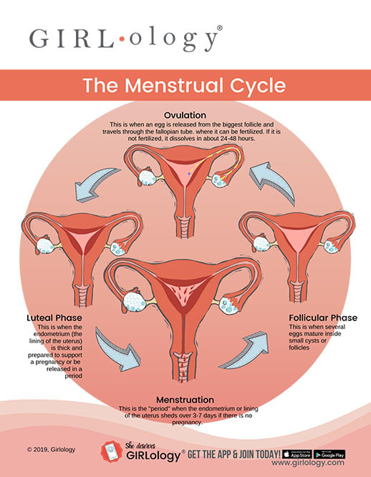
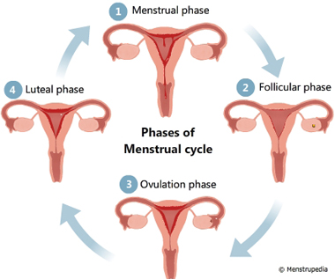
Strategies for Introducing Menstruation
Share visuals:
Menstrupedia
Tampax
Notes:
Tampax

Slide 26
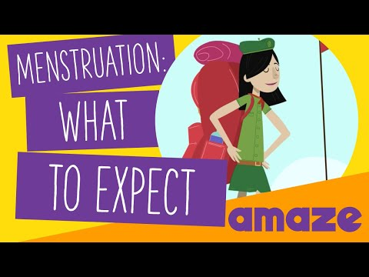
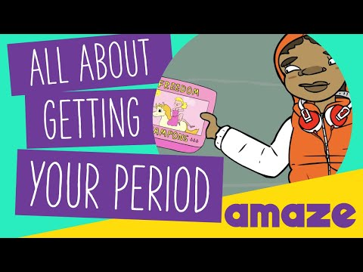
Strategies for Introducing Menstruation
Share videos:

Slide 27
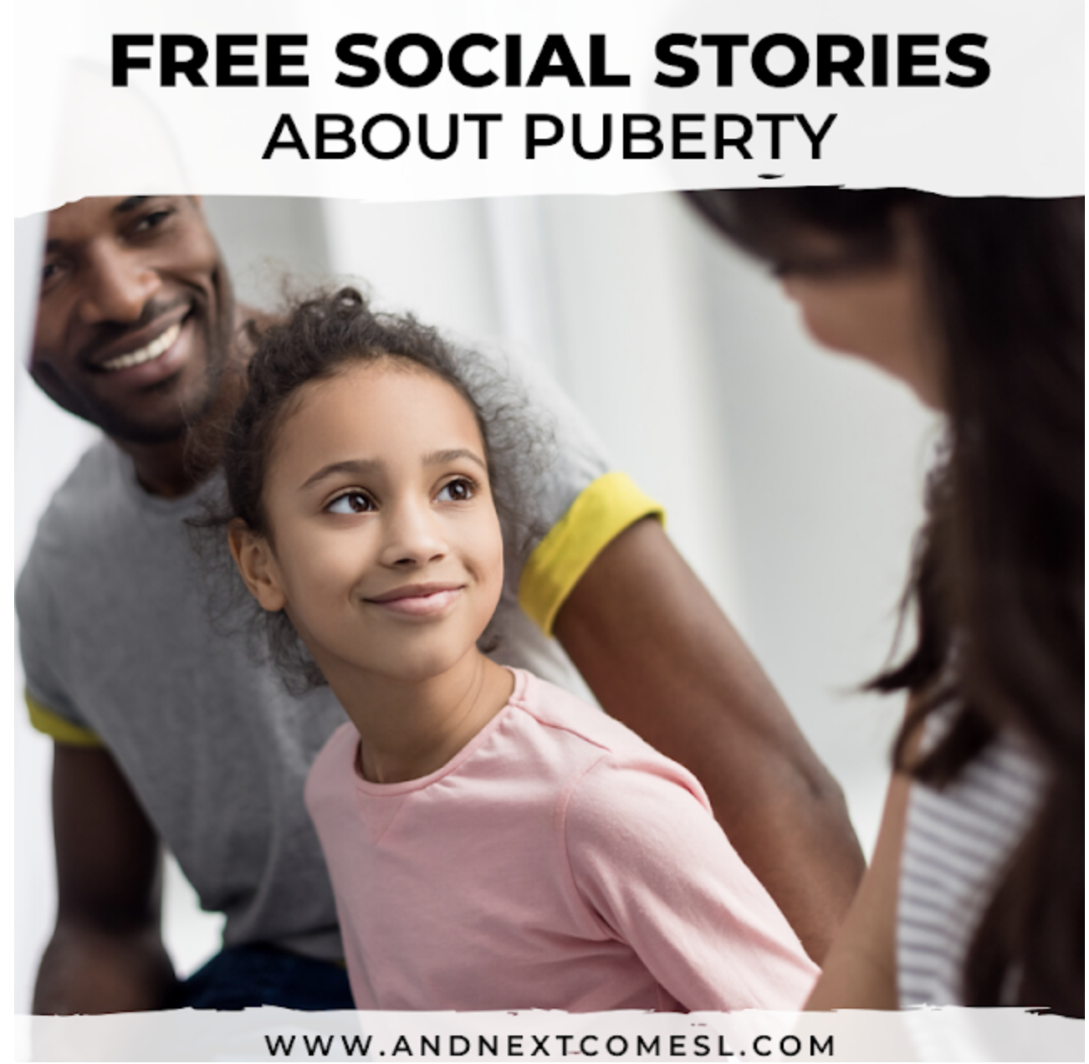
Strategies for Introducing Menstruation
Share social stories:
Helpful books:

Slide 28
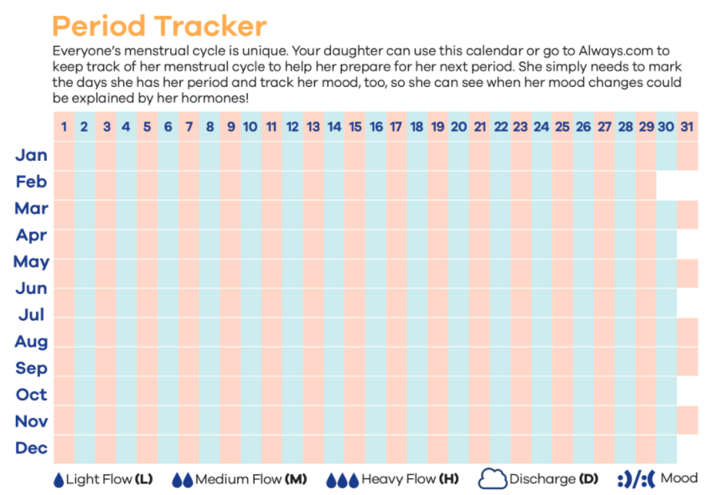
Strategies For Managing Menstruation
Consider encouraging your child to keep track of their cycle, using a chart such as this →

Slide 29
Social-Emotional Changes

Slide 30
Social-Emotional Changes
Due to hormones, your child may experience emotional changes, as well.
Increased worry about fitting in, relationships, the demands of school, etc.
Increased moodiness
Potential for greater behavioral outbursts.
Your child may begin to experience feelings of sexual arousal.

Slide 31
Social-Emotional Changes
Your child may strive for more independence.
Arguments may become more regular.
Your child may have difficulty monitoring and expressing their emotions.
Risk-taking behavior may increase during puberty.

Slide 32
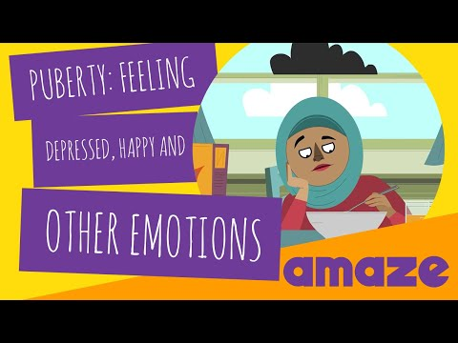
Strategies for Social-Emotional Changes
Share a video:

Slide 33
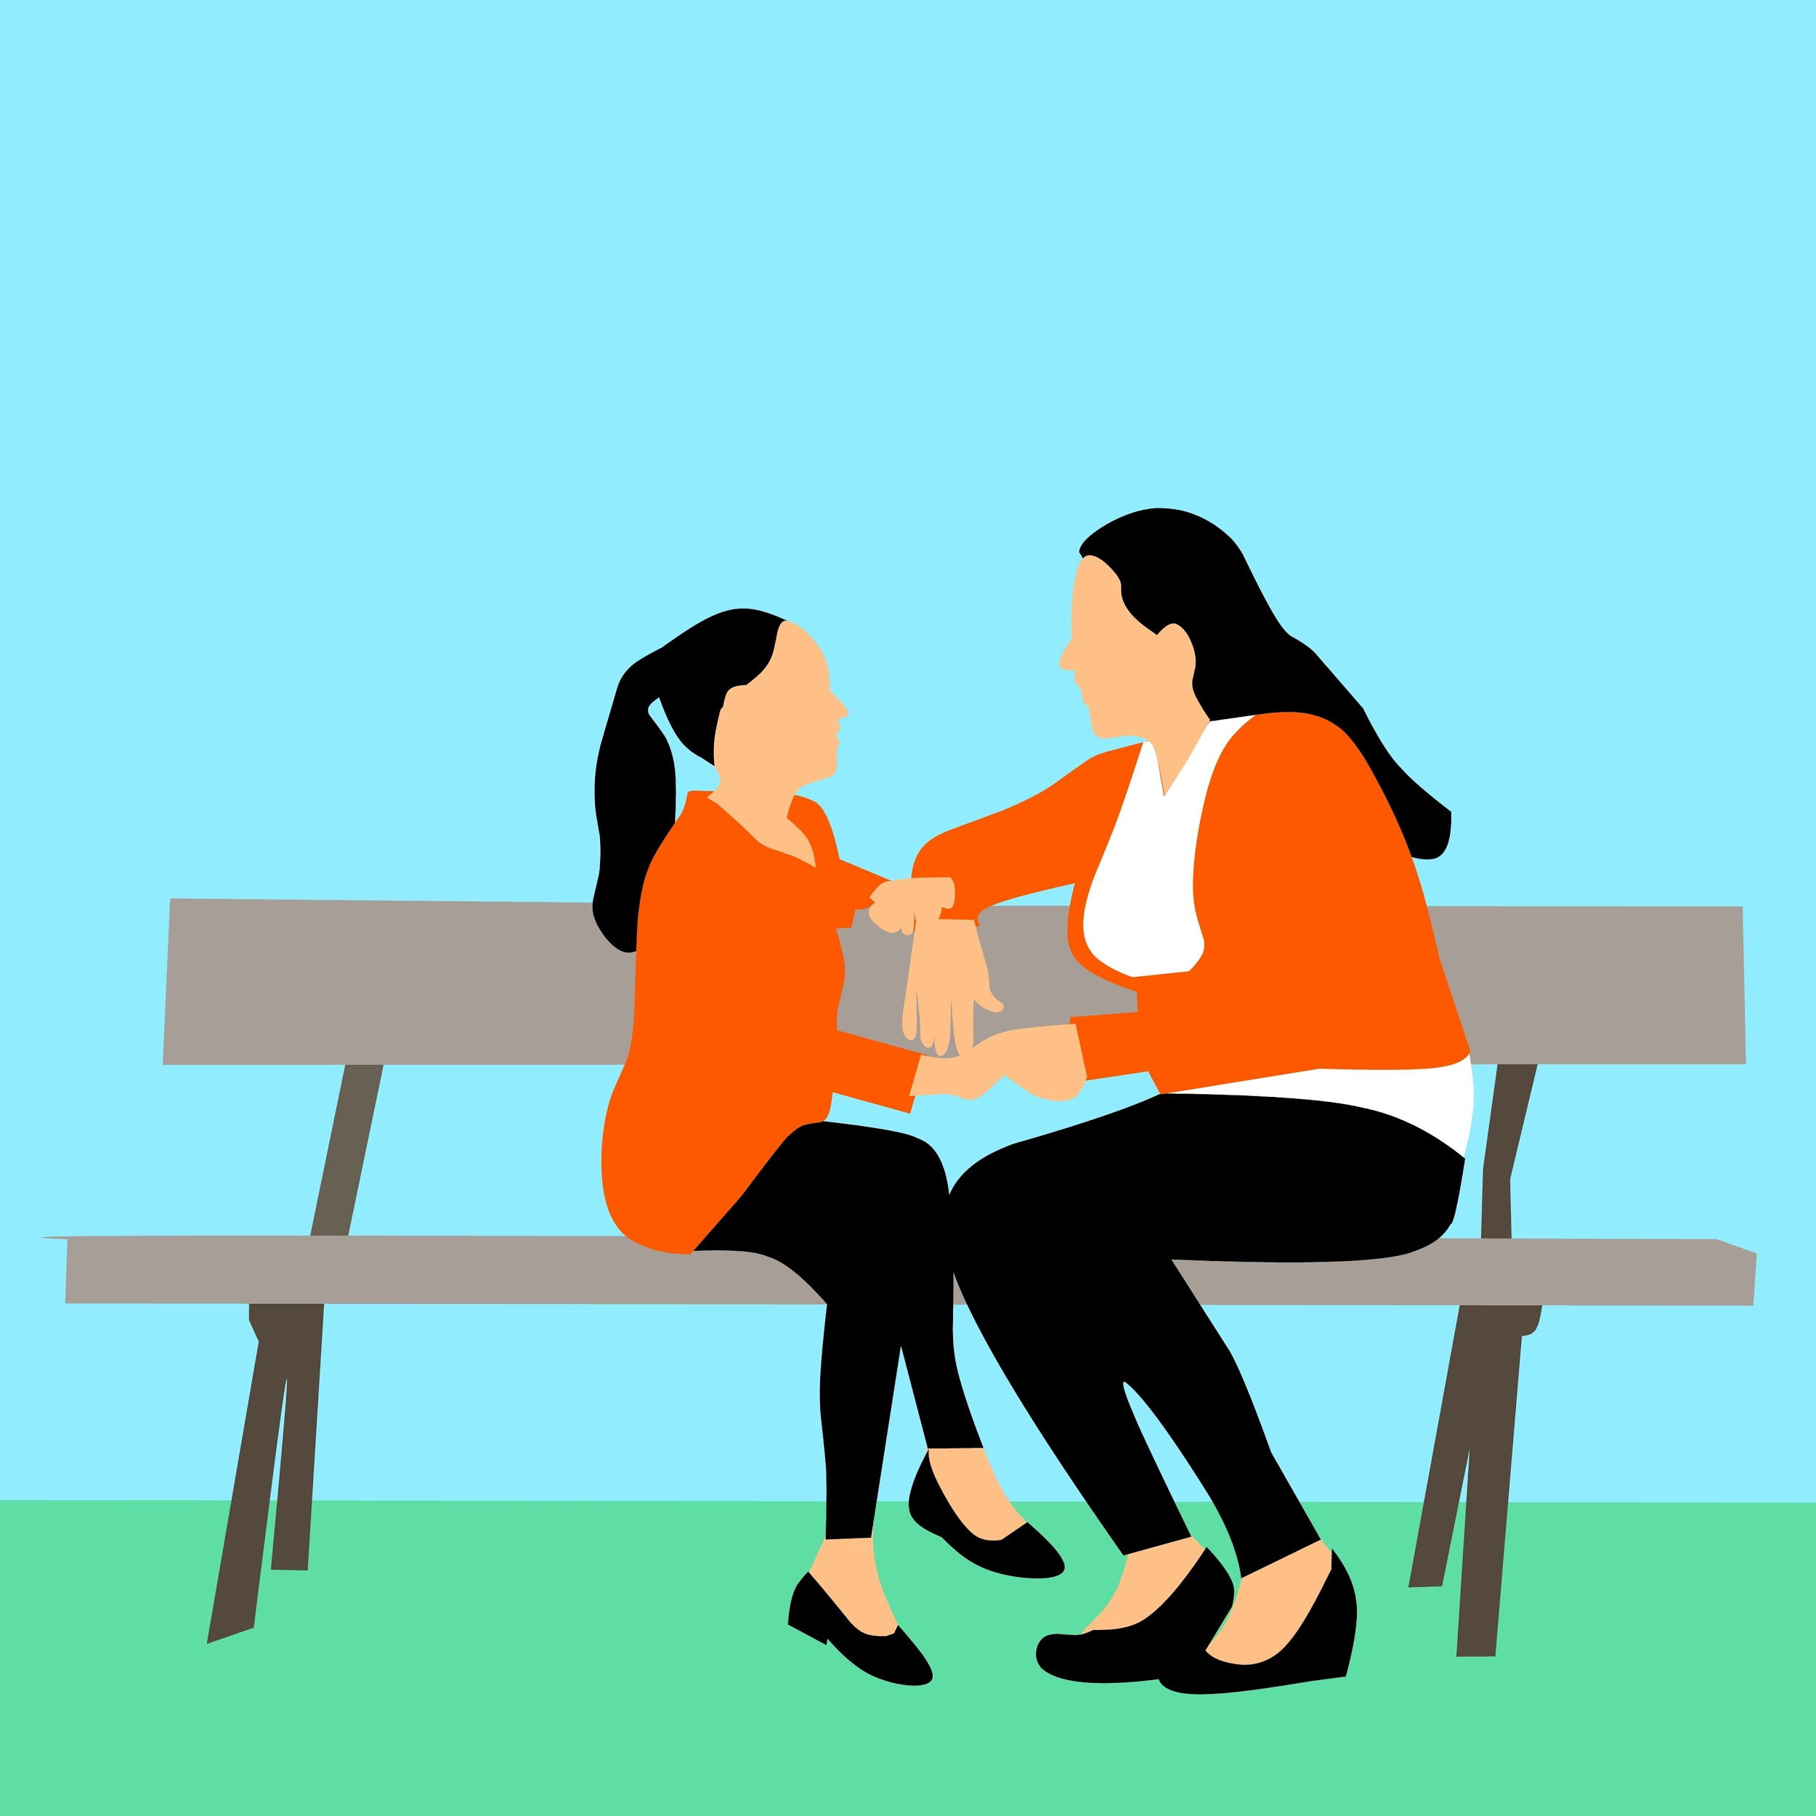
Strategies for Social-Emotional Changes
Communication:
Create an open-door policy when it comes to talking with your child.
If you are too busy to talk, set up a time to chat.
Look for natural moments to discuss relationships, emotions, puberty, and hygiene.
Your child may feel embarrassed to bring it up.
Kids may turn to the internet to answer their questions. Discuss internet safety.

Slide 34
Strategies for Social-Emotional Changes
Encourage self exploration, self-confidence, and coping skills through journals and books:

Slide 35
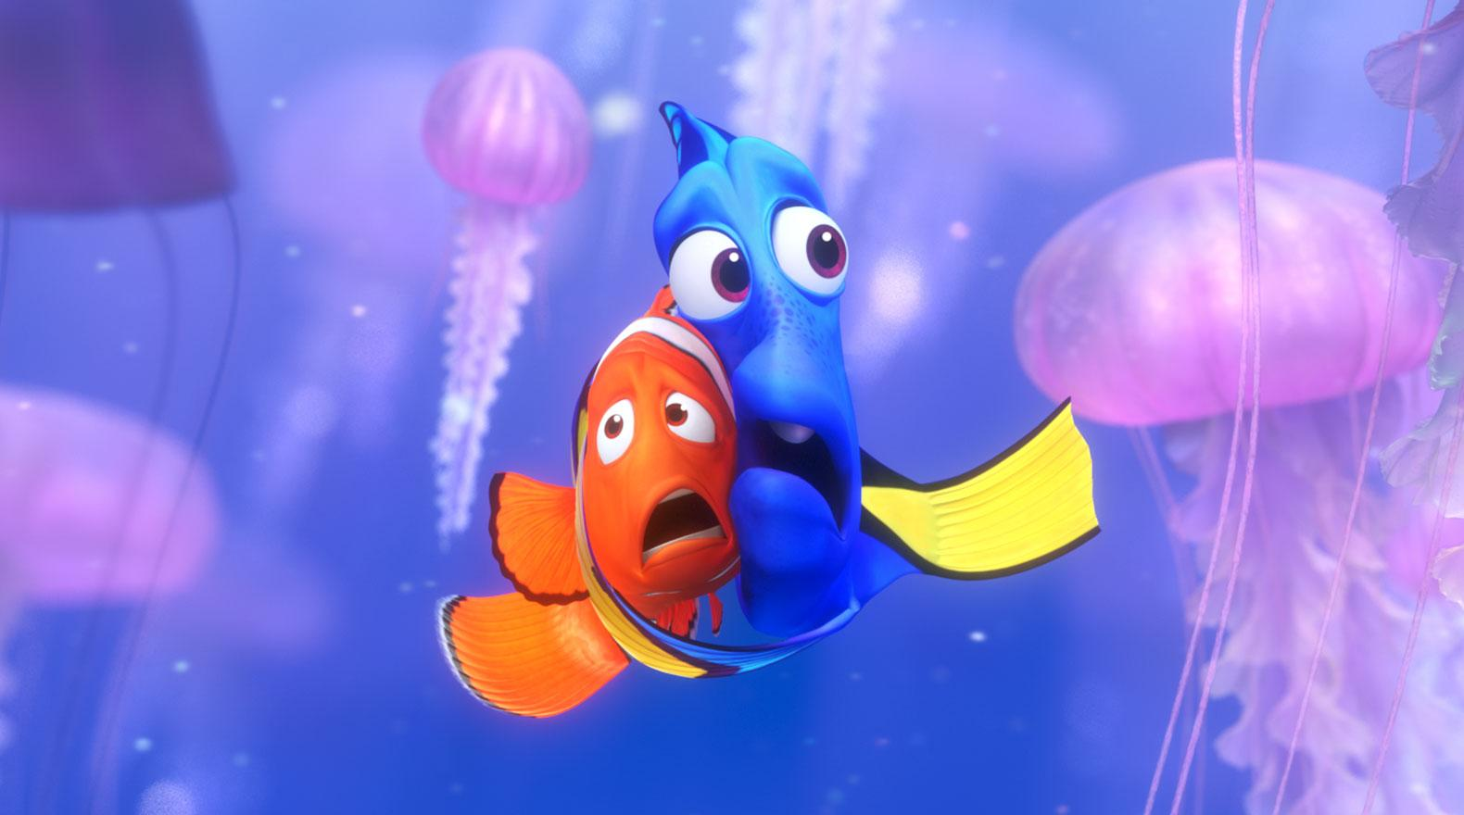
Hygiene
Discussion Question: What is your child’s independence level with hygiene-related tasks?

Slide 36
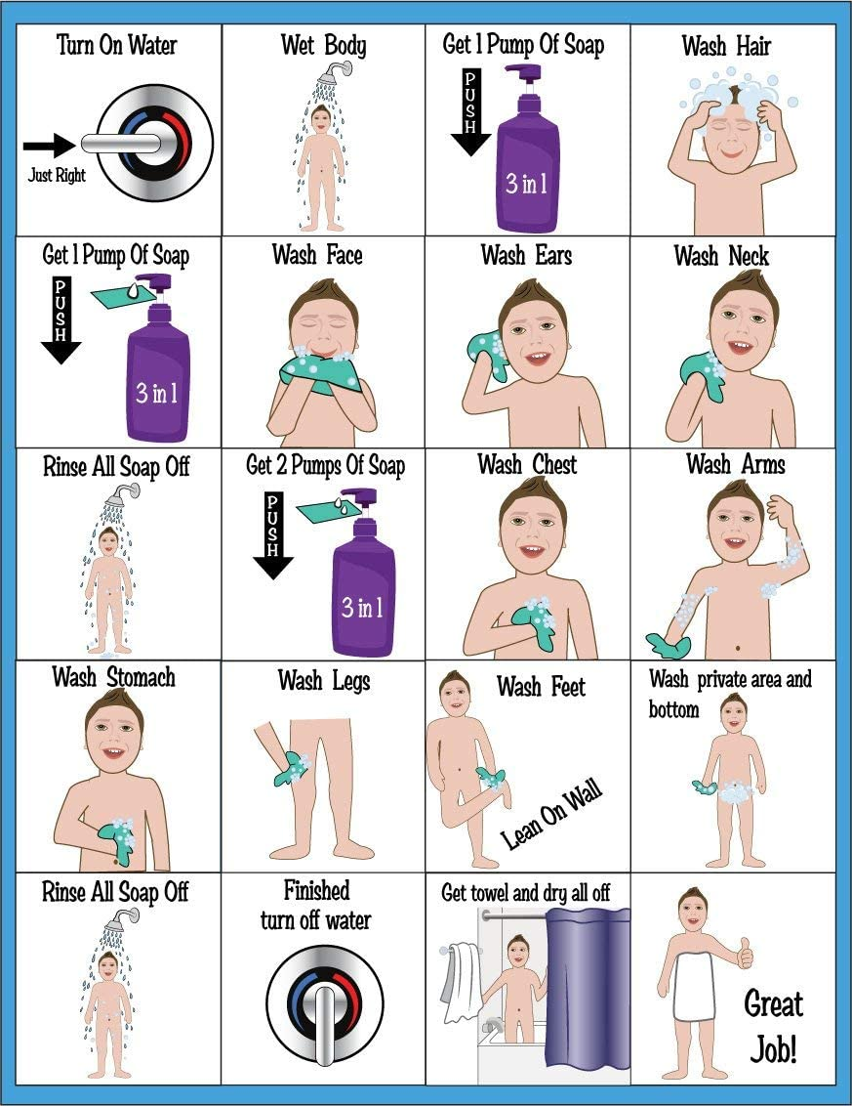
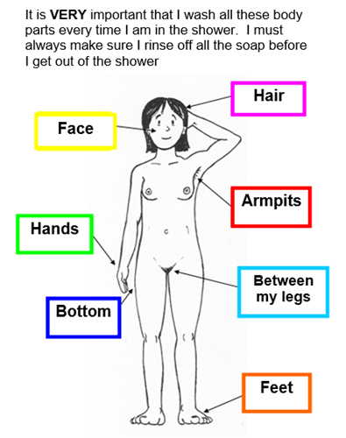
Hygiene - Washing
Increased washing during puberty.
Clean clothing should be worn after showering and daily, especially underwear.
Teach your child to brush hair and apply lotion when needed.
Brush teeth thoroughly with toothpaste and follow up with flossing.
Be explicit about what and when to wash.

Slide 37
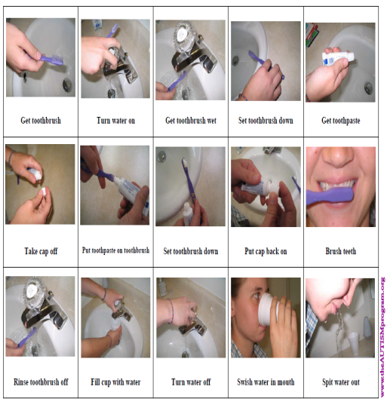
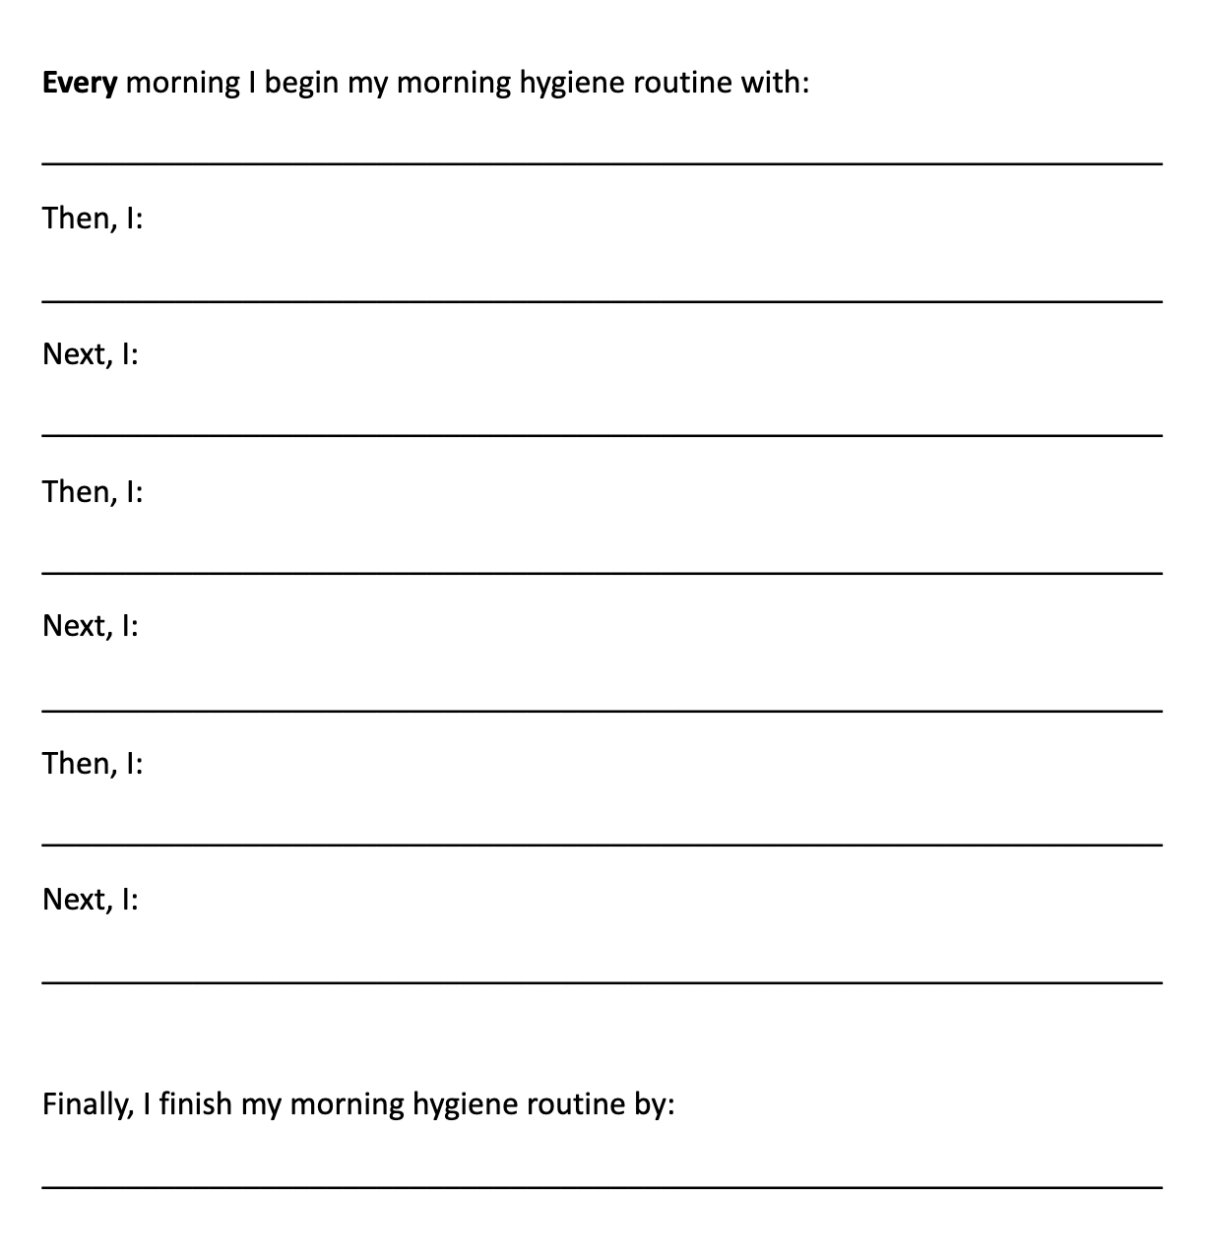
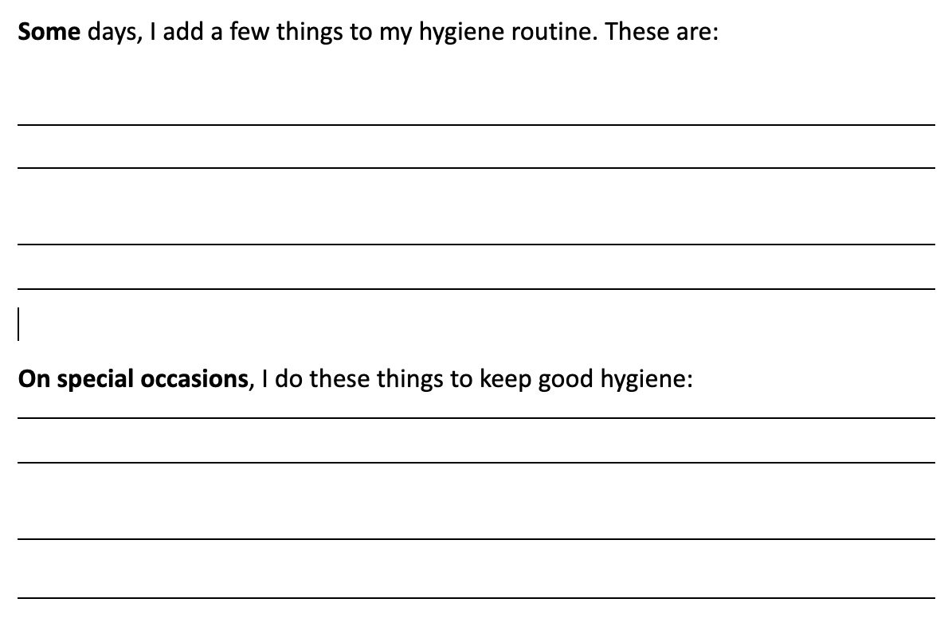
Strategies to Encourage a Hygiene Routine
Using visuals (lists or checklists) may aid your child in independent self-care:

Slide 38
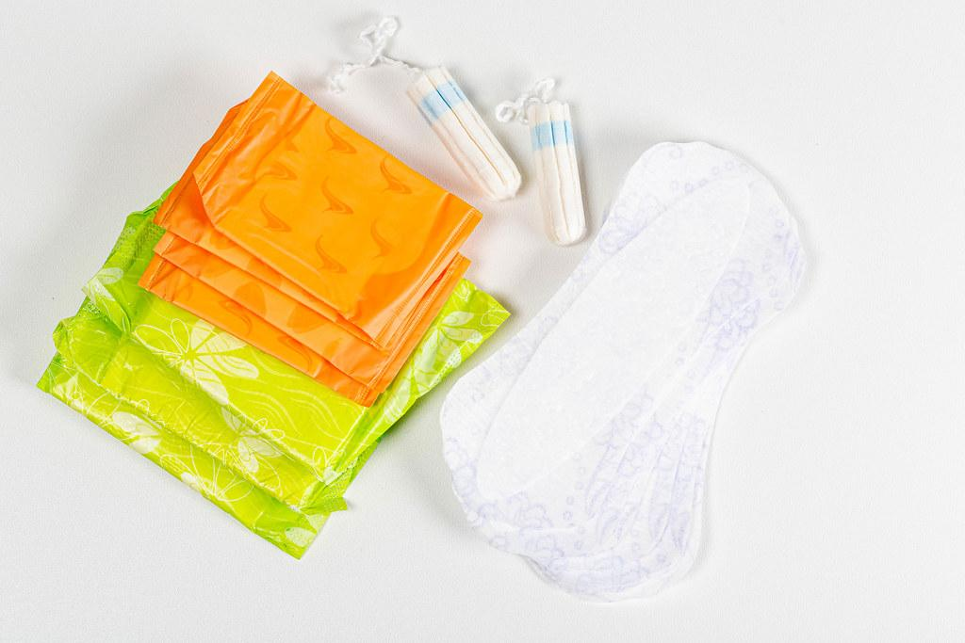
Hygiene - Period Products
Your child will need guidance about menstrual hygiene during puberty.
Douches, feminine sprays, and scented tampons can lead to infection or negative reactions.
Let your child pick what works best for them.
Cleaning up is important when on a period!

Slide 39
Strategies to Help Teach Good Hygiene
Help your child feel empowered by making a list of pros and cons of the different period products to use:
Product | How to Use | Benefits | Challenges
Menstrual Cup
Reusable Period Underwear
Reusable Pad
Disposable Tampon
Disposable Pad

Slide 40
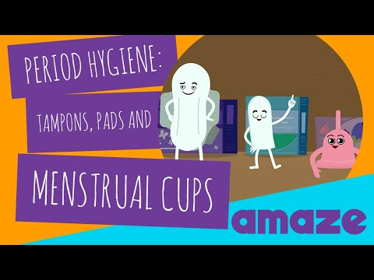
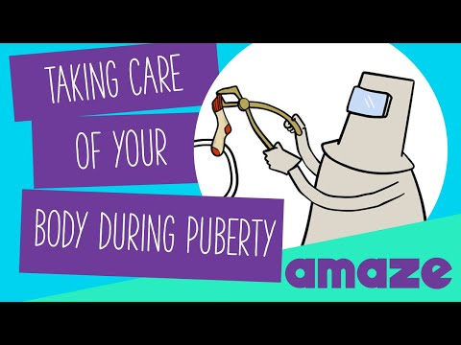
Strategies to Teach Good Hygiene

Slide 41
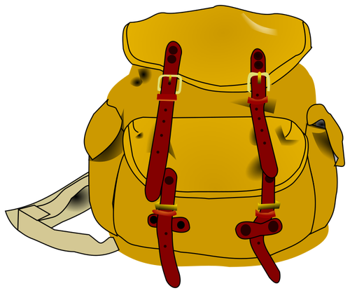
Strategies to Teach Good Hygiene
Many children feel embarrassed discussing puberty and hygiene.
Initiate the conversation!
Encourage them to pick out their own supplies (pads, deodorant, facewash, shampoo, etc.)
Send your child to school prepared with their preferred menstrual product.
Your child may need reminders at first about new hygiene demands.
Have your child reflect on why washing is important.

Slide 42
Sometimes the body parts we discussed are called “private parts.” Let’s talk more about privacy.

Slide 43
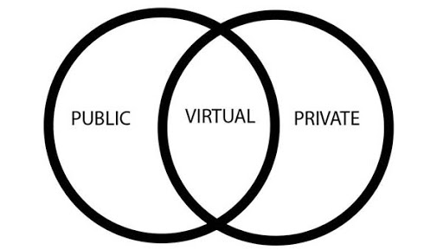
Public v. Private
Discussion question: What is your child’s understanding on the difference between public v. private?

Slide 44
Why it’s important
Hard to grasp the difference between public vs. private.
With puberty, private behaviors are likely to present more frequently/intensely.
To keep your child and others safe, it is important to teach the difference.
Public v. Private
Body Parts
Places
Language/Conversations
Activities/Behaviors

Slide 45
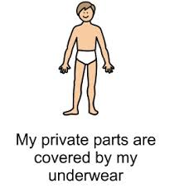
Body Parts- What to Teach
What are “private parts”
Anything covered up by a swimsuit/underwear.
We don’t show private parts in public.
We can only touch private parts in private locations.
No one should touch our private parts.
Unless we say it’s okay.
We don’t touch other people’s private parts.
Unless they say it’s okay.

Slide 46
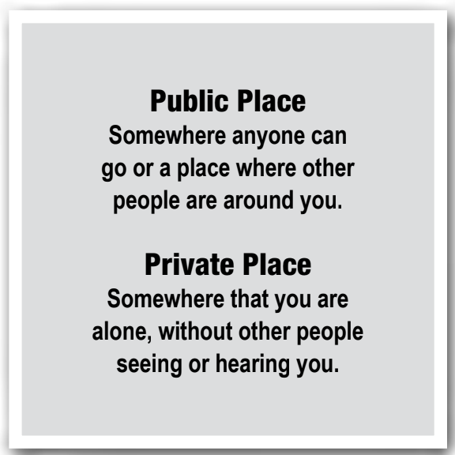
Places- What to Teach
Some places are not completely public OR private.
Example: Public bathroom or in a car.
Some private spaces are not completely private ALL the time.
Example: Bedroom.
Some public places have private spaces for certain private activities.
Example: gym/pool locker room or doctor’s office.

Slide 47
Language/Conversations- What to Teach
Private conversation = one you don’t want others to hear or others may feel uncomfortable hearing.
This includes in-person, phone, or virtual situations.
Example: discuss private parts with doctor or person you trust in-person.
Sending messages or photos over text message or the internet is NOT private.
Other private language and conversations include:
Body parts
Bodily basic functions

Slide 48
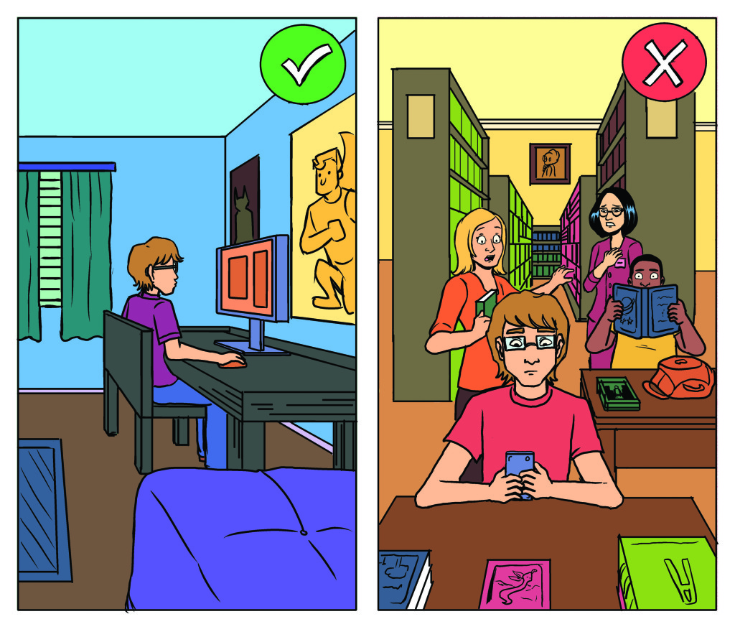
Activities/Behaviors- What to Teach
Some behaviors are not okay to do in public, including:
Exposing private parts
Scratching/touching genitals
Fixing/adjusting underclothing
Self-stimulation
Sexual behaviors
Hygiene-related and bodily functions
Toileting
Brushing teeth
Cleaning nails
Shaving
Showering

Slide 49
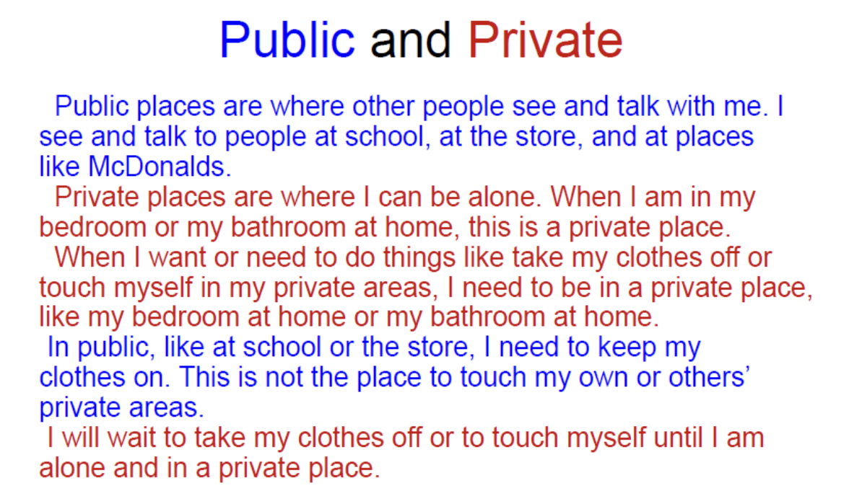
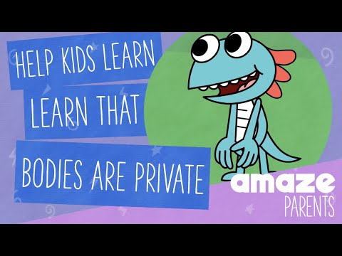
Strategies to Help Teach Public v. Private
Social Stories
Visuals and/or with words
Videos

Slide 50
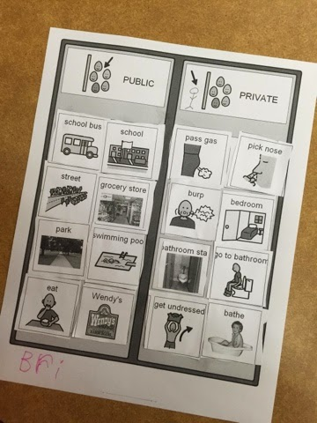
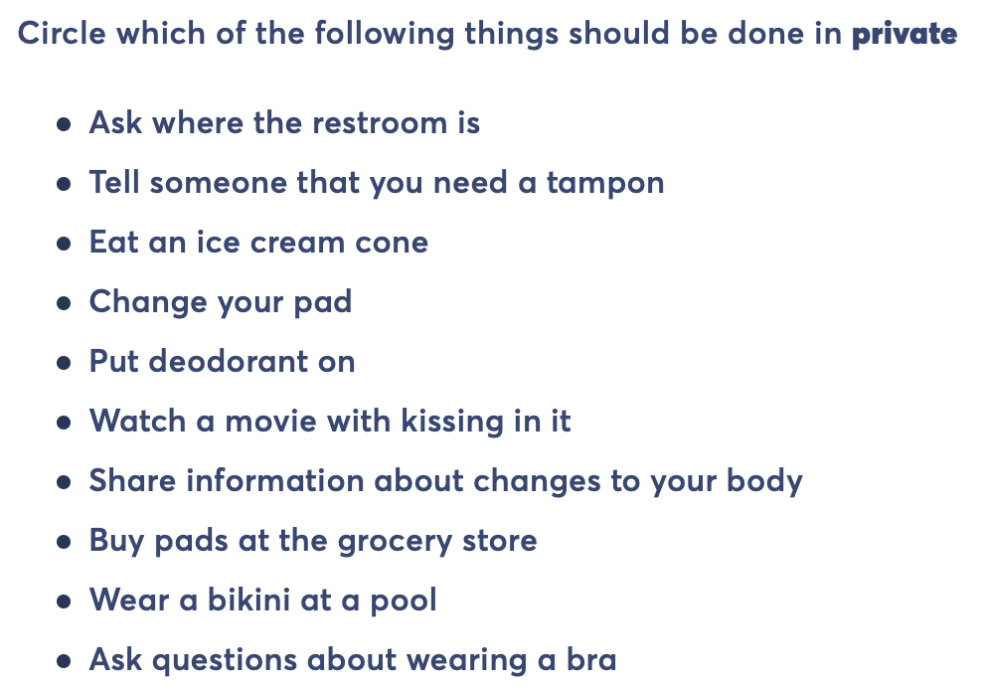
Strategies to Help Teach Public v. Private
Worksheets/Checklists
Model and Discussion
Identify rooms at home that are private (pictures/labels)
ALL family members consistently knock on doors
Use a door hanger as a visual reminder (not to enter)

Slide 51
More Resources
Amaze
Sex Positive Families
LOMAH Podcast
The Birds and The Bees
Find helpful and relatable animated videos on topics like puberty, healthy relationships, personal safety, etc.
Find useful resources including books, articles, blogs, and informational websites on topics related to sexuality.
Listen to episodes with experts in the field speaking on hot topics (pelvic exams, literacy, behavioral issues, etc.).
Share and use sexuality curriculum materials for educators, caregivers, and people on the autism spectrum.

Slide 52
References
A K-12 Sexuality Education Curriculum. Rights, Respect, Responsibility. (2021, May 17). http://3rs.org/3rs-curriculum/.
Alberta Health Services. (2016). Sexuality and Disability Guide for Parents. Teaching Sexual Health. https://teachingsexualhealth.ca/app/uploads/sites/4/Sexual-and-Development-Disablity-Guide-2016.pdf.
AMAZE - Age appropriate info on puberty for tweens and their parents. amaze / USA. (n.d.). https://amaze.org/.
Body. (2014). https://www.girlshealth.gov/body/index.html.
Capretto, J. J. C. (2020, June). Puberty, Sex, and Sexuality. Vanderbilt Kennedy Center. https://vkc.vumc.org/assets/files/resources/sexedtoolkit.pdf.
Differing Abilities: Public and Private. Alberta Health Services. (2012). https://teachingsexualhealth.ca/app/uploads/sites/4/downloads/DA-Public-and-Private.pdf.
FLASH lesson plans for Special Education. FLASH lesson plans for Special Education - King County. (2006). https://kingcounty.gov/depts/health/locations/family-planning/education/FLASH/special-education.aspx.
iEmily.com, health and wellness site for girls. (n.d.). http://iemily.com/homepage.html.

Slide 53
References
Me and My World Social Skills Teaching System. Joshua Center. (2020, December 28). https://joshuacenter.com/social-skills-teaching-system/.
OHSU. (n.d.). University Center for Excellence in Developmental Disabilities. Teaching Tools. https://www.ohsu.edu/university-center-excellence-development-disability/teaching-tools.
Parenthood, P. (n.d.). What is Menstruation?: Get Facts About Having Your Period. Planned Parenthood. https://www.plannedparenthood.org/learn/health-and-wellness/menstruation.
Proctor & Gamble. (2019). Always Changing & Growing Up. Puberty Materials for Educators. https://www.pgschoolprograms.com/Educators.
Puberty, Sexuality, and Behavior: How to Guide Young People with Disabilities. INCLUDEnyc. (2017, October 10). https://www.includenyc.org/images/uploads/content/Puberty,_Sexuality,_and_Behavior_packet.pdf.
The Curriculum. Relationships Decoded. (n.d.). https://relationshipsdecoded.com/curriculum-agree/.
The Nemours Foundation. (n.d.). Puberty & Growing Up. KidsHealth. https://kidshealth.org/en/kids/grow/?WT.ac=k-nav-grow.

Slide 54
References
Vanderbilt Leadership Education in Neurodevelopmental Disabilities. (2013, June). The Healthy Bodies Toolkit. https://vkc.vumc.org/healthybodies/.
Veronica et al. (2015, April 20). My Curriculum (free). The Birds and The Bees. https://asdsexed.org/category/curriculum/my-curriculum-free/.

