Slide 1
Social Emotional Learning (SEL): At-Home Curriculum for ATLAS students

Slide 2
Check-In
Call a Friend
Go For a Walk
How are you feeling?
Some emotions to expect:
Anxiety, worry, or fear
Concern
Frustration
Loneliness
Anger
Boredom
Uncertainty
Sadness
What have you done to relax or de-stress?
Read a Book
Try a Mindfulness Activity

Slide 3
Mindful Breathing

Slide 4
Highly Satisfying Videos

Slide 5
Practice Mindfulness!
What is mindfulness?
Purposely bringing your attention to the experiences going on in the moment and not judging

Slide 6
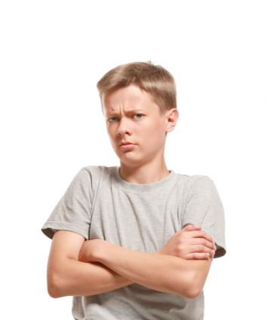
Jumping to Conclusions
What do you think this person is about to do?
Whenever you try to guess what someone’s thinking without much evidence, you’re jumping to conclusions
Based on your conclusions, what would you do if this person were walking towards you?

Slide 7
Think & Discuss with a Family Member
People often jump to negative conclusions without considering other possibilities
Examples: Your teacher wants to talk to you one-on-one in the hallway. Your friend hasn’t texted you back in days.
What can make it difficult to jump to a positive conclusion?

Slide 8
Activity
Choose 1 scenario
3 scenarios will be listed on the next slide
Come up with 3 conclusions about what’s happening
At least 1 conclusion must be positive

Slide 9
Scenario Options for Activity
Scenario 1:
A kid you barely know just sent you a mean e-mail.
Scenario 2:
You walk into class and kids start laughing.
Scenario 3:
You're working really hard to get your project done, but your partner's not doing anything.

Slide 10
Wrap-Up: Big Takeaways from Lesson
Correctly guessing what other people are thinking is really hard.
What can happen if you jump to negative conclusions about someone that ends up being wrong?
Possible answers: the person no longer trusts you/wants to be your friend, the person’s feelings are hurt

Slide 11
More Practice: Create a FlowChart

Slide 12
Directions
As a reminder, an example of a flowchart is below!
Create a flowchart that shows what happens if you
A) “Jumped to a conclusion”
B) Considered other reasons

Slide 13
What’d You Come Up With?
Classmate keeps staring at me
Yell “What do you want?” to student
Student starts yelling at back
Student tries to fight you
You engage in the fight
You and the student are sent to the principal’s office
You’re both suspended
You think “he’s probably trying to start something with me..”
Classmate keeps staring at me
You attempt to ignore the student
Student eventually stops staring
You both go back to your schoolwork
You think “maybe it’s an accident or they’re just tired.”

Slide 14
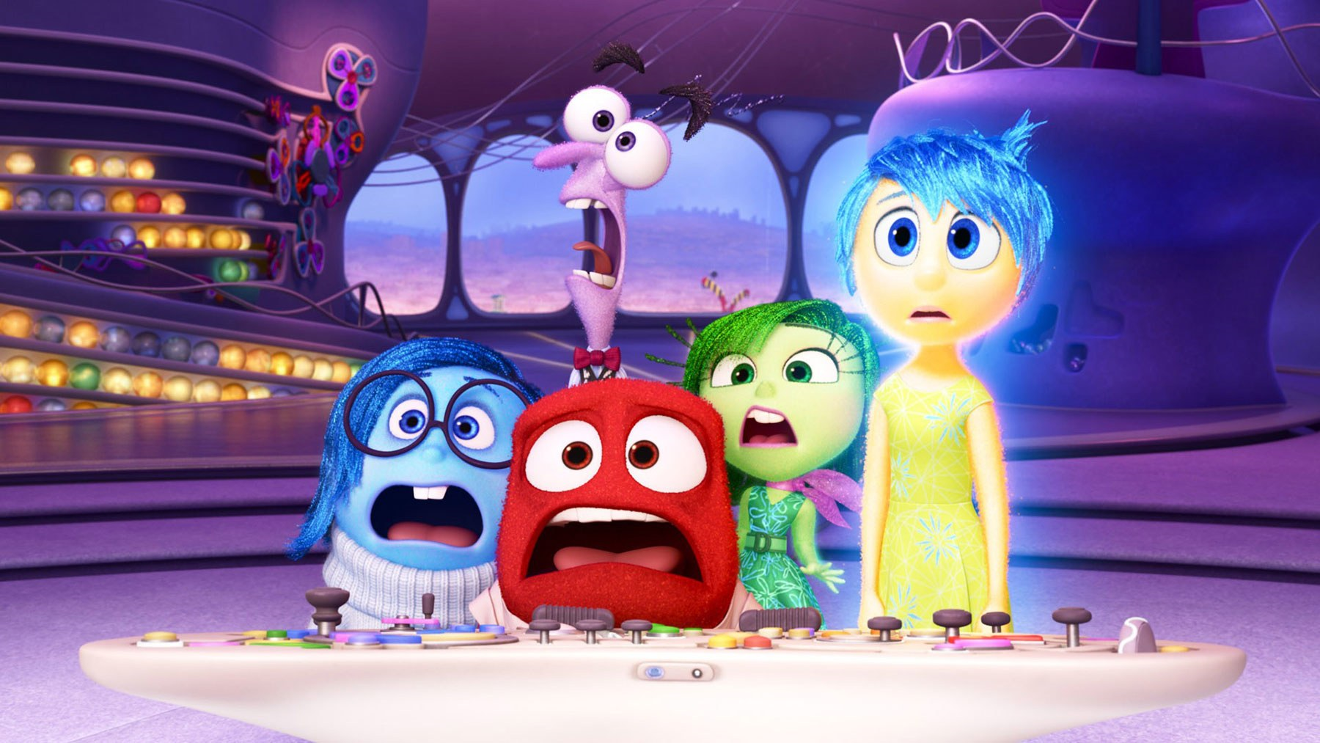
Inside Out
If you’d like to keep watching at home (optional), we left off at the 30- minute mark
Review of what we’ve watched in class:
Riley’s Islands of Personality: Goofball Island, Honesty Island, Family Island, Hockey Island, Friendship Island
Riley has five emotions in her control center (brain):
Joy, Sadness, Anger, Disgust, and Fear
Riley and her family move from Minnesota to San Francisco
Riley loses her core memories as well as Joy and Sadness from her control center

Slide 15
Activity
What are your Islands of Personality?
Not sure? Ask a parent or sibling what they think!

Slide 16
Resources
Content was adapted from that provided by SAMHSA and the CDC:
https://store.samhsa.gov/system/files/sma14-4894.pdf
https://www.cdc.gov/coronavirus/2019-ncov/prepare/managing-stress-anxiety.html?CDC_AA_refVal=https%3A%2F%2Fwww.cdc.gov%2Fcoronavirus%2F2019-ncov%2Fabout%2Fcoping.html
https://www.cdc.gov/coronavirus/2019-ncov/prepare/managing-stress-anxiety.html?CDC_AA_refVal=https%3A%2F%2Fwww.cdc.gov%2Fcoronavirus%2F2019-ncov%2Fabout%2Fcoping.html
Other helpful resources include:
https://www.apa.org/practice/programs/dmhi/research-information/social-distancing
https://www.apa.org/practice/programs/dmhi/research-information/pandemics
https://www.nctsn.org/sites/default/files/resources/fact-sheet/outbreak_factsheet_1.pdf
Recursos en español son:
https://store.samhsa.gov/system/files/sma14-4885spanish.pdf
https://store.samhsa.gov/system/files/sma14-4893spanish.pdf

