Slide 1
Providing Accessible Services for Students who are Blind/Visually Impaired or Deaf/Hard of Hearing
Paige Furbush, M.Ed, LSLS Cert. AVT

Slide 2
Terminology
B/VI: Blind/Visually Impaired
TVI: Teacher of the Visually Impaired
O&M: Orientation & Mobility
CI: Cochlear Implant
HA: Hearing Aid
D/HH: Deaf/Hard of Hearing (d/Deaf)
TOD: Teacher of the Deaf
ASL: American Sign Language
LSL: Listening and Spoken Language
Hard of Hearing (NEVER “hearing impaired”)

Slide 3
Let’s cover some basics…
Sensory Impairments (hearing loss, vision loss, deafblindness) are all considered to be low-incidence disabilities
In Utah, children with a visual impairment make up 0.5% of children with disabilities receiving services under Part C of IDEA & 0.3% of children receiving services under Part B (data source: http://www.ideadata.org)
Children who are Deaf/Hard of Hearing make up 1.2% of children with disabilities receiving services under Part C & 0.9% of children receiving services under Part B (data source: http://www.ideadata.org)
As IDEA has evolved, LRE is widely accepted to mean the general education classroom, and inclusion has become the goal for students with disabilities.

Slide 4
Statistics
Estimated 40-50% of students who are D/HH have an additional disability (Nelson & Bruce, 2019)
Estimated that 9% of children who are D/HH have ASD (Do et. al., 2017)
Estimated 50% of students who are B/VI have a LD (Steinberg et al., 2002)
Estimated that 19% of children who are B/VI have ASD (Do et al, 2017)
Optic Nerve Hypoplasia (ONH)
Retinopathy of Prematurity (ROP)
Anophtalmia/Microphthalmia

Slide 5
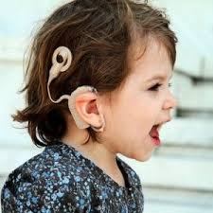
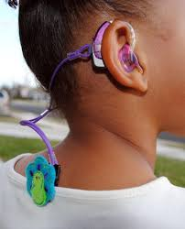
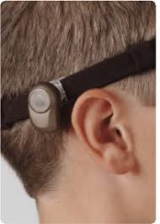
Students who are D/HH
Ensuring access, considerations, issues with assessment, & impact on social skills

Slide 6
Deafness & Hearing Loss: What’s the difference?
Deaf vs. deaf
Deaf culture vs. hearing culture
Huge diversity in experiences of individuals with a hearing loss
Typically see students who use hearing technology & spoken language in inclusive settings

Slide 7
When a child is born with a hearing loss, the amount of auditory input they receive is reduced. This means that the auditory pathway does not develop appropriately, making understanding and developing speech incredibly difficult.
Humans are pre-wired to learn spoken language by listening.
Most people think we hear with our ears, but really, we hear with our brain.

Slide 8
Degrees of Hearing Loss
Mild
May miss 25-40% of speech
Moderate
May miss 50-80% of speech
Severe
Likely missing all speech sounds, but responds to environmental sounds
Profound
May only feel vibrations without amplification

Slide 9
Considerations for Students who are D/HH

Slide 10
It’s all about ACCESS
Assistive technology (HAs, CIs) is not a substitute for normal hearing.
Comprehension is significantly impacted when background noise is present, at a distance, and when more than one person are speaking at once.

Slide 11
Children with hearing loss often struggle with:
Hearing & understanding sounds around them
Hearing & producing speech sounds (morphology)
Learning new vocabulary
Putting sentences together & using correct grammar (syntax)
Understanding more advanced components of language, such as figurative speech, plays on words etc. (semantics)
Having the language & vocabulary to effectively express themselves
Following directions
Paying attention
Following along in conversations with others

Slide 12
Increasing Access
Reduce background noise
Monitor equipment/lighting that may be emitting noise (HVAC, fluorescent lighting on ceiling, computers, projectors etc.)
Keep curtains/shutters on windows down or closed
Seat student away from windows
Keep door to the room closed
Be mindful of flooring (carpet is better than hard flooring since the sound doesn’t bounce around as much)

Slide 13
Increasing Access (cont’d)
Decrease the distance between you and the student
Face the student when speaking
Get to know the child’s listening preferences
Explain words with multiple meanings and idioms directly
Use multiple modes of representation (i.e. manipulatives, role plays, pictures, videos, etc.)
Speak more clearly (NOT louder!)
Use the ”listen” cue

Slide 14
Increasing Access (cont’d)
USE FM SYSTEMS
Ensures a favorable signal-to-noise ratio (SNR)
Provides additional access to sound in difficult listening situations by transmitting the speaker’s voice directly to the HA or CI, which eliminates interference from background noise
FM improves overall understanding by making sound audible and intelligible (easier listening!)
Personal FM systems allow for the best speech recognition when compared to a classroom soundfield FM (but any amplification is better than nothing!)

Slide 15
Assessment for Students who are D/HH

Slide 16
Issues with Assessment
Conducting valid cognitive assessments is a topic that is hotly debated among professionals in our field
Less assessment instruments considered reliable and valid
Often see lower IQ scores among this population when compared to same-age, hearing peers

Slide 17
Widely Accepted Cognitive/Intellectual Tests
Wechsler Intelligence Scale for Children: Fourth Edition (WISC IV)
Stanford-Benet Intelligence Scale-Fifth Edition
Universal Nonverbal Intelligence Test (UNIT)
Wechsler Nonverbal Scale of Ability (WNV)
Woodcock-Johnson Tests of Cognitive Abilities, 3rd Ed.

Slide 18
During Assessment:
Ensure technology is working properly by checking the device itself & performing a Ling 6 check
Use optimal positioning
Make sure you have the child’s auditory attention
Administer assessment in an optimal listening environment (minimal background noise, speak at close range, use FM)
Provide plenty of wait time between your direction and the child’s response

Slide 19
Impact of Hearing Loss on Social Skills

Slide 20
Miss out on incidental social skill learning opportunities
Need explicit social skills instruction & compensatory skills
Minnesota Social Skills Checklist for Students who are D/HH
More likely to feel lonely or unhappy at school
Social problems more apparent in children with a mild/moderate loss
Communication delays impact ability to interact socially
Less likely to participate in group activities
Theory of Mind issues
Self-advocacy

Slide 21
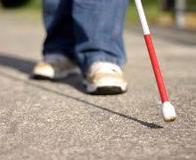
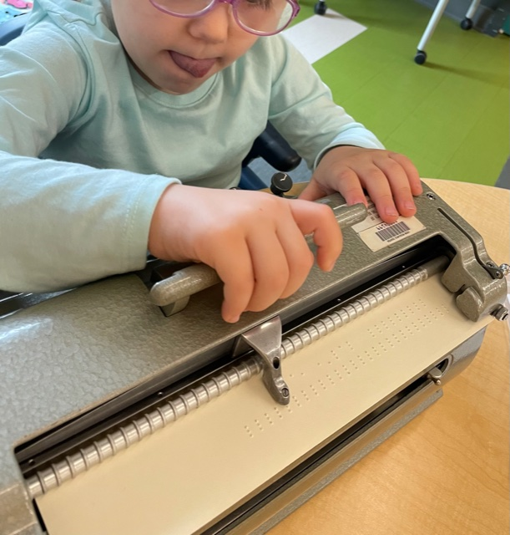
Students who are B/VI
Ensuring access, considerations, issues with assessment, & impact on social skills

Slide 22
Blindness is a spectrum
Low Vision
Functionally Blind
Blind
Impact of the visual impairment is tied to the onset, severity, type of vision loss, and any additional disabilities that may be present

Slide 23
Know the etiology!
Is the child’s vision loss ocular or neurological?
Neurological etiologies often increase the likelihood of the child having additional disabilities (ASD, LD etc.)
Etiologies that are ocular in nature are less likely to have additional disabilities; however, some ocular disorders are part of specific syndromes and there may be concomitant CNS involvement

Slide 24
Considerations for Students who are B/VI

Slide 25
Increasing Access
Be mindful of lighting (typically want to increase illumination)
Reduce glare
Decrease distance between the child & the visual target
Be aware of the direction of light source for students who are sensitive to glare

Slide 26
Increasing Access (cont’d)
Use high contrast materials
Keep the location of furniture & materials consistent
Keep your room safe! Chairs should be pushed in, cabinets closed, and doors either completely shut or all the way open.
Allow time for room familiarization

Slide 27
Increasing Access (cont’d)
Use color contrast to bring student attention to specific materials, objects, landmarks etc.
Be mindful of preferred visual fields, field loss etc.
Optimal visual access
Familiarize yourself with the student’s assistive technology
Talk! Get used to giving verbal descriptions of what you or others are doing

Slide 28
Basic Etiquette
Always introduce yourself by stating your name when you greet the student
When the student is with you, and you greet someone in passing, be sure to greet them by name so the student knows who it is
Don’t be afraid to use words like “look”, as they are common expressions that everyone uses
Avoid using hand signals
Give verbal cue before initiating any kind of physical contact

Slide 29
Basic Etiquette (cont’d)
Be specific & label objects with direction & location words
Avoid phrases like “it’s over there!” or “right here!”
Instead, use phrases like, “it’s on the table to your right”
Don’t jump out of the way when you see a blind student walking with their cane
Don’t leave a person with a visual impairment talking to themselves. Let them know when you are leaving.

Slide 30
Assessment for Students who are B/VI

Slide 31
Issues
The topic of valid administration of intelligence tests for this population is also a topic of contention in our field
Accessibility of the measures depends on the type and degree of the student’s vision loss

Slide 32
Before beginning the assessment process…
Meet with the student’s TVI
Review the eye report
Review the FVA (Functional Vision Assessment) & the LMA (Learning Media Assessment)
Collaborative evaluation process is crucial

Slide 33
Widely Accepted Cognitive/Intellectual Tests
WISC-R Verbal Subtests
Low vision & functionally blind
WISC-R Performance Subtests
Moderately low vision students (20/100 or more & no significant field losses)
*Most common approach is for psychologists to use the Verbal subscales of a test, but issues with reliability are still debated

Slide 34
Impact of Vision Loss on Social Skills

Slide 35
Miss out on the majority of incidental social skill learning opportunities
75-80% of everything we learn is through vision
Many people have lower expectations for B/VI students’ social functioning in general
Don’t have access to others’ social cues
Body language, facial expressions, gestures

Slide 36
Explicit instruction in social skills is key!
Consider things like:
Nonverbal behaviors to indicate interest
Respecting personal space of others
Make contact according to cultural norms
Turning face to the speaker
Facial expressions
Tone of voice
Behaviors that might cause social isolation
Compensatory skills
Listening before joining a group
Discussing their VI openly
Asking others for a description of what’s going on

Slide 37
Resources

Slide 38
For Students who are D/HH
ASHA
www.asha.org
Types of hearing loss, evidence-based strategies for working with students who are D/HH, deciphering the audiogram
Success for Kids with Hearing Loss
www.successforkidswithhearingloss.com
Tons of resources, including specific resources for school psychs
@listenwithlindsay
On Instagram. Pediatric audiologist & blogger. Covers lots of topics related to hearing loss, including AT & Telehealth tips
@mama.hu.hears
On Instagram. Audiologist & CI user. Great info (& graphics!) about accessibility, understanding different devices, & Telehealth tips
Hearing First
www.hearingfirst.org
More information about LSL, hearing technology support, strategies to support auditory skills
NASP
Position statement on serving children with hearing loss

Slide 39
For Students who are B/VI
*Perkins
www.perkinselearning.org
The BEST when it comes to learning more about specific etiologies & ALL topics related to vision loss. Amazing PD materials.
*TSBVI
www.tsbvi.edu
Texas School for the Blind/Visually Impaired. Enormous resource library covering ALL topics related to vision loss, including research articles, assessment, accommodations etc.
@blindishlatina
On Instagram. Talks a lot about self advocacy, accessibility, & disability rights in general.
Teaching Visually Impaired (Blog)
www.teachingvisuallyimpaired.com
Adaptations & instructional resources
Family Connect
www.familyconnect.org
Lots of info on different topics. Great resource for families.

Slide 40
Thank you!

Slide 41
Supplemental Information
Include in the normative evaluation report
Direct observation in a variety of settings
Consider:
Visual efficiency in unfamiliar settings
Visual fatigue
Organizational abilities in problem-solving
Presence of potentially isolating self-stimulatory behaviors
How the student interacts socially with peers

